Slide 1
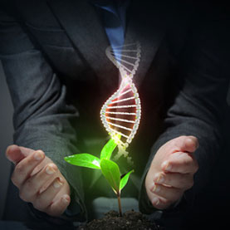
BIOTECHNOLOGY PRINCIPLES AND PROCESS

Slide 2
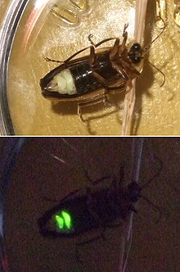
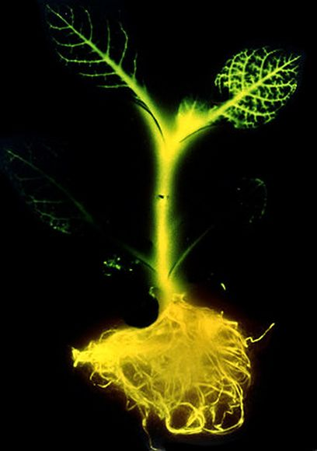
Tobacco plant
1986
Gene taken from a firefly

Slide 3
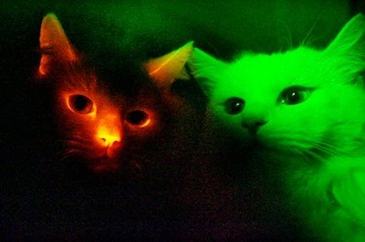

Slide 4
Definition of ‘biotechnology’
Numerous definitions depending upon whether :
Traditional
Modern processes
OR
are considered

Slide 5

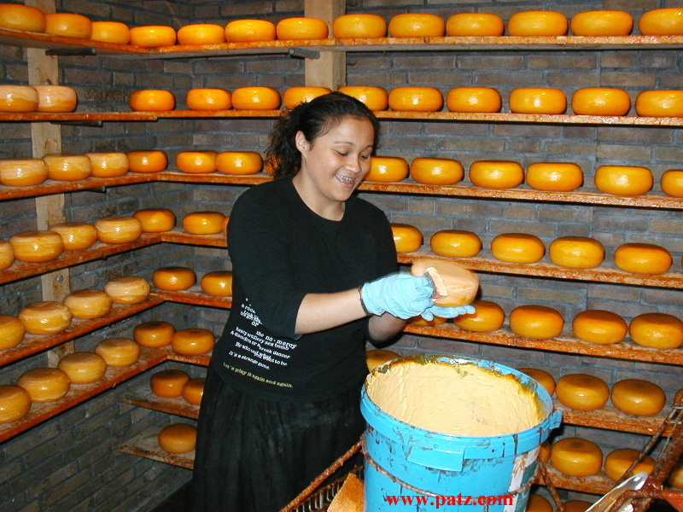
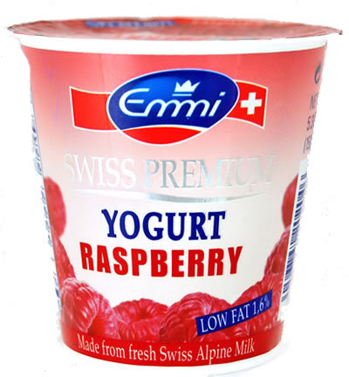
Traditional Definition:
‘The use and exploitation of microorganisms to produce products of industrial or commercial interest like beer brewing, cheese making, and production of sour milk.’

Slide 6
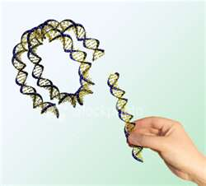
Modern definition:
The application of scientific and engineering principles to the processing of materials by biological agents to provide goods and services

Slide 7
The European Federation of Biotechnology (EFB)
The European Federation of Biotechnology (EFB) has given a definition of biotechnology that encompasses both traditional view and modern molecular biotechnology.
The definition given by EFB is as follows:
‘The integration of natural science and organisms, cells, parts thereof, and molecular analogues for products and services’.

Slide 8
PRINCIPLES OF BIOTECHNOLOGY
Among many, the two core techniques that enabled birth of modern biotechnology are :
(i) Genetic engineering : Techniques to alter the chemistry of genetic material (DNA and RNA) to introduce these into host organisms and thus change the phenotype of the host organism.

Slide 9
CON…….
(ii) Maintenance of sterile (microbial contamination-free) ambience in chemical engineering processes to enable growth of only the desired microbe/eukaryotic cell in large quantities for the manufacture of biotechnological products like antibiotics, vaccines, enzymes, etc.

Slide 10
Conceptual development of the principles of genetic engineering.
The techniques of genetic engineering which include creation of recombinant DNA.
Use of gene cloning and gene transfer, overcome this limitation.
To isolate and introduce only one or a set of desirable genes without introducing undesirable genes into the target organism.

Slide 11
CONT……..
There are three basic steps in genetically modifying an organism —
(i) Identification of DNA with desirable genes;
(ii) Introduction of the identified DNA into the host;
(iii) Maintenance of introduced DNA in the host and transfer of the DNA to its progeny.

Slide 12
CLONING
An alien DNA is linked with the origin of replication, so that, this alien piece of DNA can replicate and multiply itself in the host organism.
This can also be called as cloning or making multiple identical copies of any template DNA.

Slide 13
PLASMID
The construction of the first recombinant DNA emerged from the possibility of linking a gene encoding antibiotic resistance with a native plasmid (autonomously replicating circular extra-chromosomal DNA) of Salmonella typhimurium.
Stanley Cohen and Herbert Boyer accomplished this in 1972 by isolating the antibiotic resistance gene by cutting out a piece of DNA from a plasmid which was responsible for conferring antibiotic resistance.
A plasmid can be used as vector to deliver an alien piece of DNA into the host organism.

Slide 14
Plasmid
The cutting of DNA at specific locations became possible with the discovery of the so-called ‘molecular scissors’– restriction enzymes.
The cut piece of DNA was then linked with the plasmid DNA.
These plasmid DNA act as vectors to transfer the piece of DNA attached to it.

Slide 15
Plasmid
The linking of antibiotic resistance gene with the plasmid vector became possible with the enzyme DNA ligase, which acts on cut DNA molecules and joins their ends.
This makes a new combination of circular autonomously replicating DNA created in vitro and is known as recombinant DNA.
When this DNA is transferred into Escherichia coli, a bacterium closely related to Salmonella, it could replicate using the new host’s DNA polymerase enzyme and make multiple copies.
The ability to multiply copies of antibiotic resistance gene in E. coli was called cloning of antibiotic resistance gene in E. coli.

Slide 16
TOOLS OF RECOMBINANT DNA TECHNOLOGY
Genetic engineering or recombinant DNA technology can be accomplished only if we have the key tools, i.e.,
1. Restriction enzymes,
2. Vectors
3. Polymerase enzymes,
4.Ligases,
5.The host organism.

Slide 17
1.RESTRICTION ENZYMES
Restriction enzymes belong to a larger class of enzymes called nucleases.
These are of two kinds; exonucleases and endonucleases.
Exonucleases remove nucleotides from the ends of the DNA whereas,
Endonucleases make cuts at specific positions within the DNA.

Slide 18
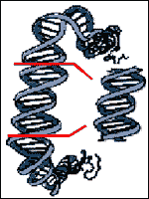
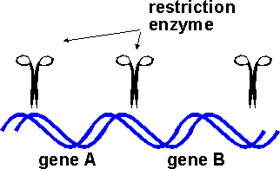
RESTRICTION ENZYMES
  a genetic engineer uses naturally-occurring enzymes to cleave (cut) DNA
In the year 1963, the two enzymes responsible for restricting the growth of bacteriophage in Escherichia coli were isolated. One of these added methyl groups to DNA, while the other cut DNA. The later was called restriction endonuclease.
Source of enzymes:
  all organisms, including bacteria, must have ways of dealing with their enemies

Slide 19
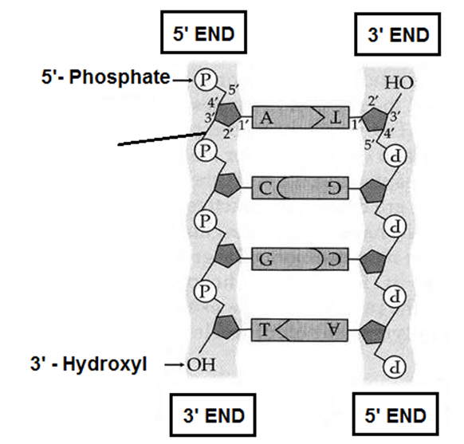
Restriction enzymes break the bond of the DNA backbone between the:
3’ OH group of one nucleotide
and
5’ PO₄⁻ group of the next nucleotide

Slide 20
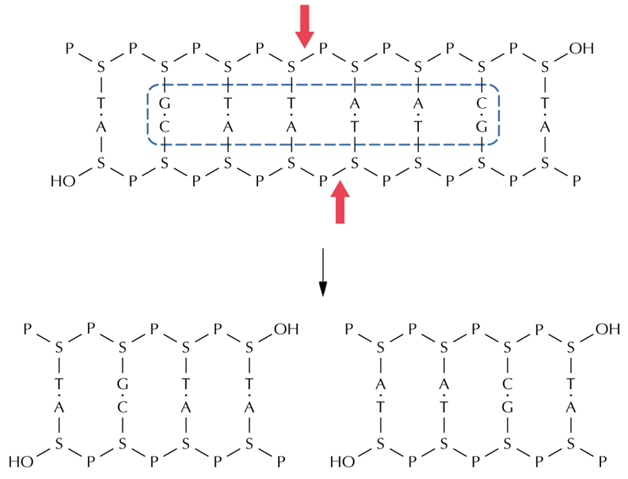
The phosphoester bond is broken:

Slide 21
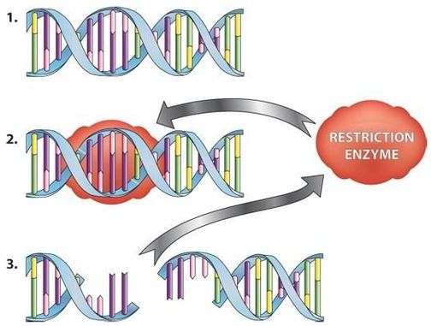
Restriction digestion: the cutting process
restriction enzymes cut double-stranded DNA into smaller pieces
act like molecular scissors, chopping up DNA molecules into restriction fragments

Slide 22
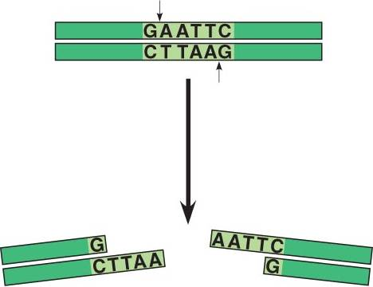
  Each restriction enzyme cleaves the DNA at a specific sequence of bases:
  Recognition sequence / Restriction site
Restriction site
[most recognition sites are 4-6 base pairs long]
Restriction fragment

Slide 23
Naming of restriction enzymes:
Names are based on the bacteria in which they are isolated
e.g.
EcoRI
E – Escherichia (genus)
co – coli (species)
R – RY 13 (strain)
I – First identified Order

Slide 24
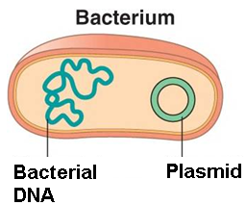
What does the Roman numeral mean?
EcoRI
1st enzyme extracted from Escherichia coli
HindIII
3rd enzyme extracted from Haemophilus influenzae
1st enzyme extracted
2nd enzyme extracted
3rd enzyme extracted

Slide 25
Recognition site of EcoRI
5’GGATCGAATTCCCGATTTCAAT
3’CCTAGCTTAAGGGCTAAAGTTA
A palindrome reads the same left-to-right in the top strand And right-to-left in the bottom strand

Slide 26
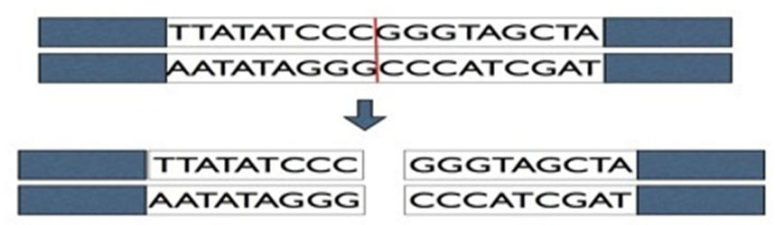
Restriction enzymes cleave DNA in two ways:
1. straight cuts:
Enzymes make incisions in each strand at a point immediately opposite the another, producing “blunt end” DNA fragments

Slide 27
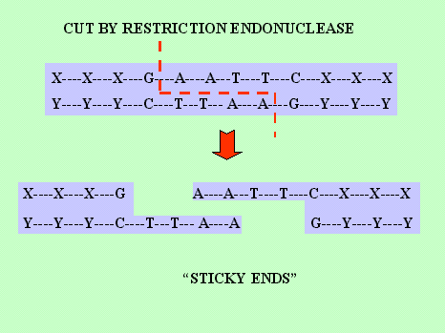
Restriction enzymes cleave DNA in two ways:
2. Staggered cuts
are in a zig-zag pattern
producing “sticky ends”

Slide 28
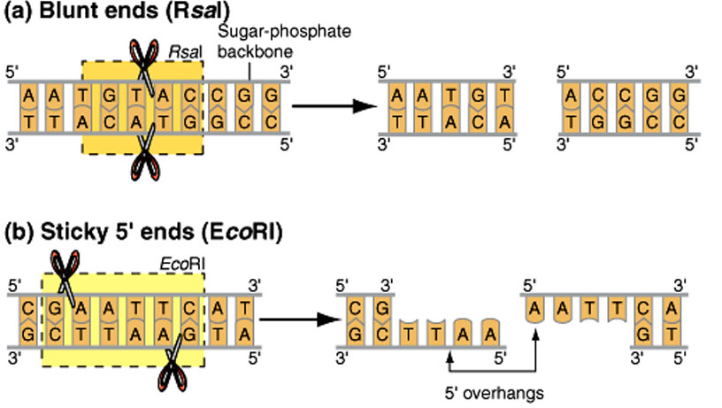
Blunt and Sticky ends
Blunt ends: paired base sequences at the ends of DNA
Sticky ends:
unpaired base sequences at the ends of DNA

Slide 29
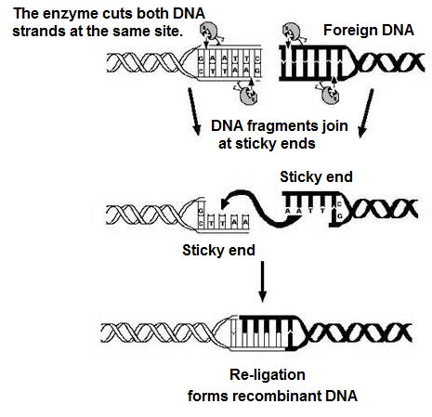
Sticky ends must match
(be complementary) for optimal
re-ligation

Slide 30
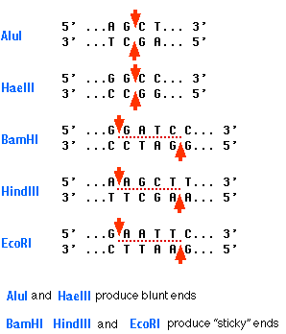
Blunt or Sticky ends?
  Blunt ends
  Sticky ends

Slide 31
Separation and isolation of DNA fragments
The cutting of DNA by restriction endonucleases results in the fragments of DNA. These fragments can be separated by a technique known as gel electrophoresis.

Slide 32
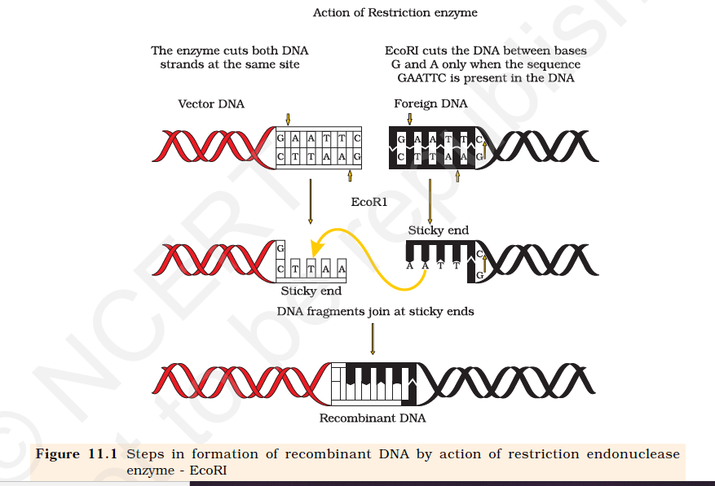

Slide 33
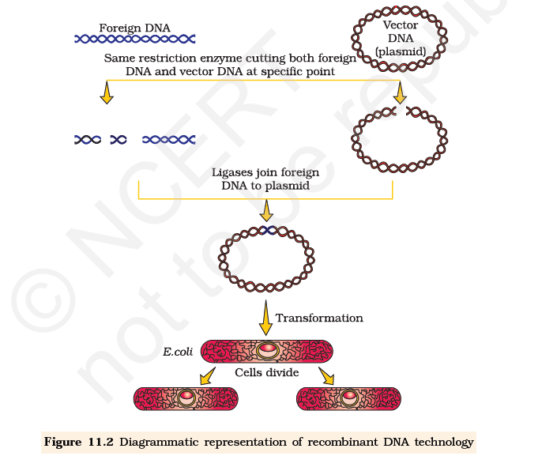

Slide 34

RESTRICTION ENZYMES

Slide 35
PRINCIPLES OF BIOTECHNOLOGY

Slide 36
Separation and isolation of DNA fragments :
The cutting of DNA by restriction endonucleases results in the fragments of DNA.
These fragments can be separated by a technique known as gel electrophoresis.
Since DNA fragments are negatively charged molecules they can be separated by forcing them to move towards the anode under an electric field through a medium/matrix.
Nowadays the most commonly used matrix is agarose which is a natural polymer extracted from sea weeds.
The DNA fragments separate (resolve) according to their size through sieving effect provided by the agarose gel.
Hence, the smaller the fragment size, the farther it moves.

Slide 37
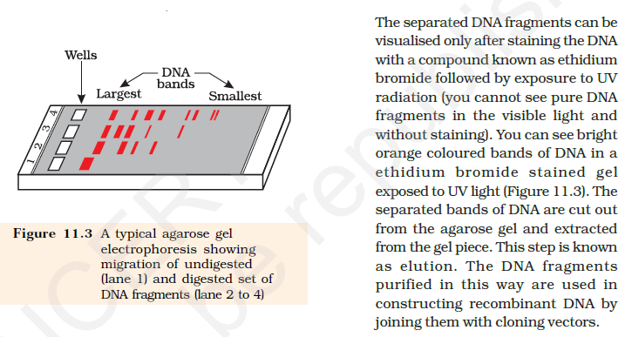

Slide 38
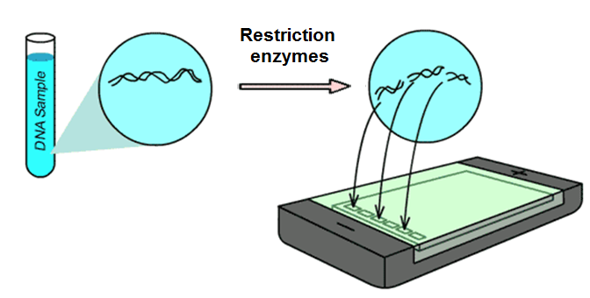
After a sample of DNA has been cut with a restriction enzyme:
The DNA is in fragments that must be separated to identify (map) where the cuts were made

Slide 39
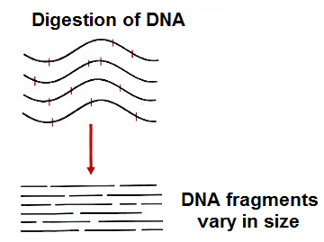
The fragments vary in size because the :
recognition sequence
does not occur
at regular intervals

Slide 40
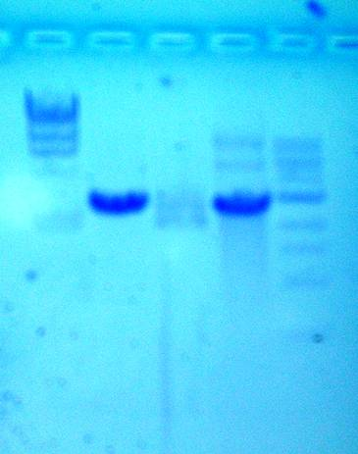
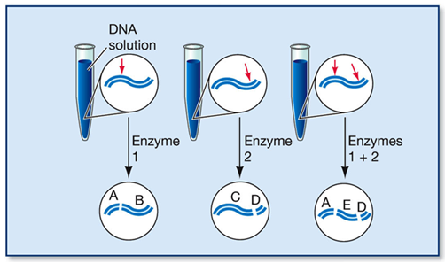
The different DNA fragments produced can be separated according to their size by:
Gel electrophoresis

Slide 41
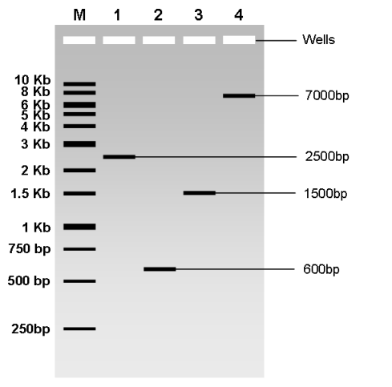
Separating the fragments is necessary to:
1. Determine the number and molecular sizes (in base pairs) of the fragments produced
2. Identify and purify an individual fragment for:
further analysis or
for use in an experiment
Migration of DNA fragments in agarose gel. Kb = kilobase = 1000 base pairs.

Slide 42
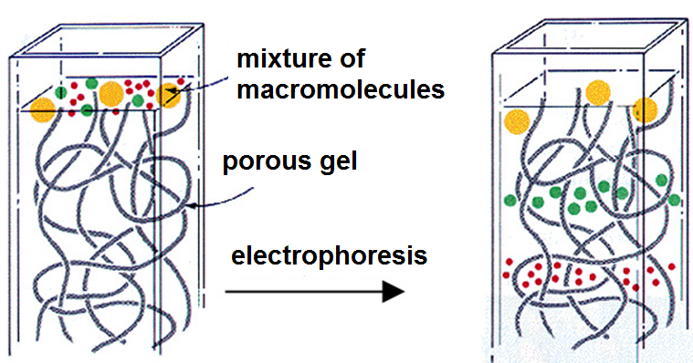
Gel Electrophoresis
Separates all sorts of molecules especially:
Proteins
Nucleic acids

Slide 43
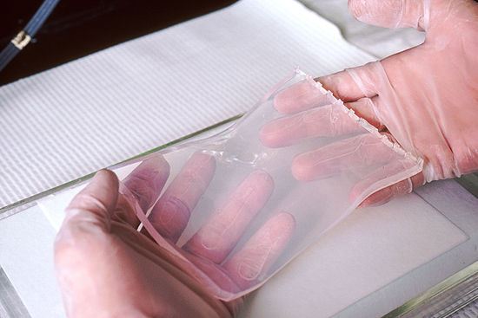
Gel Electrophoresis
gel

Slide 44
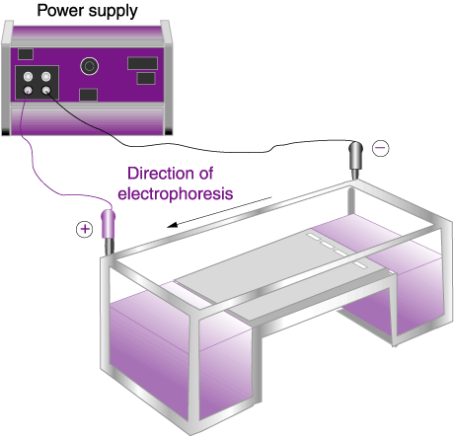
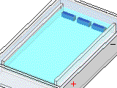
Switch on & run for a certain time (e.g. 1 hour).
-

Slide 45
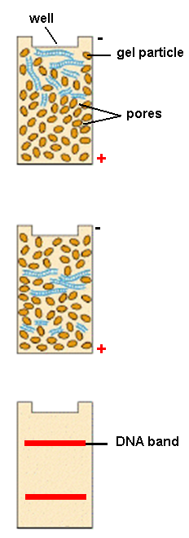
Agarose gel has pores
DNA fragments move through pores in gel.
Smallest fragments move most.
Subject to autoradiography or a fluorescent dye, DNA fragments become visible.

Slide 46
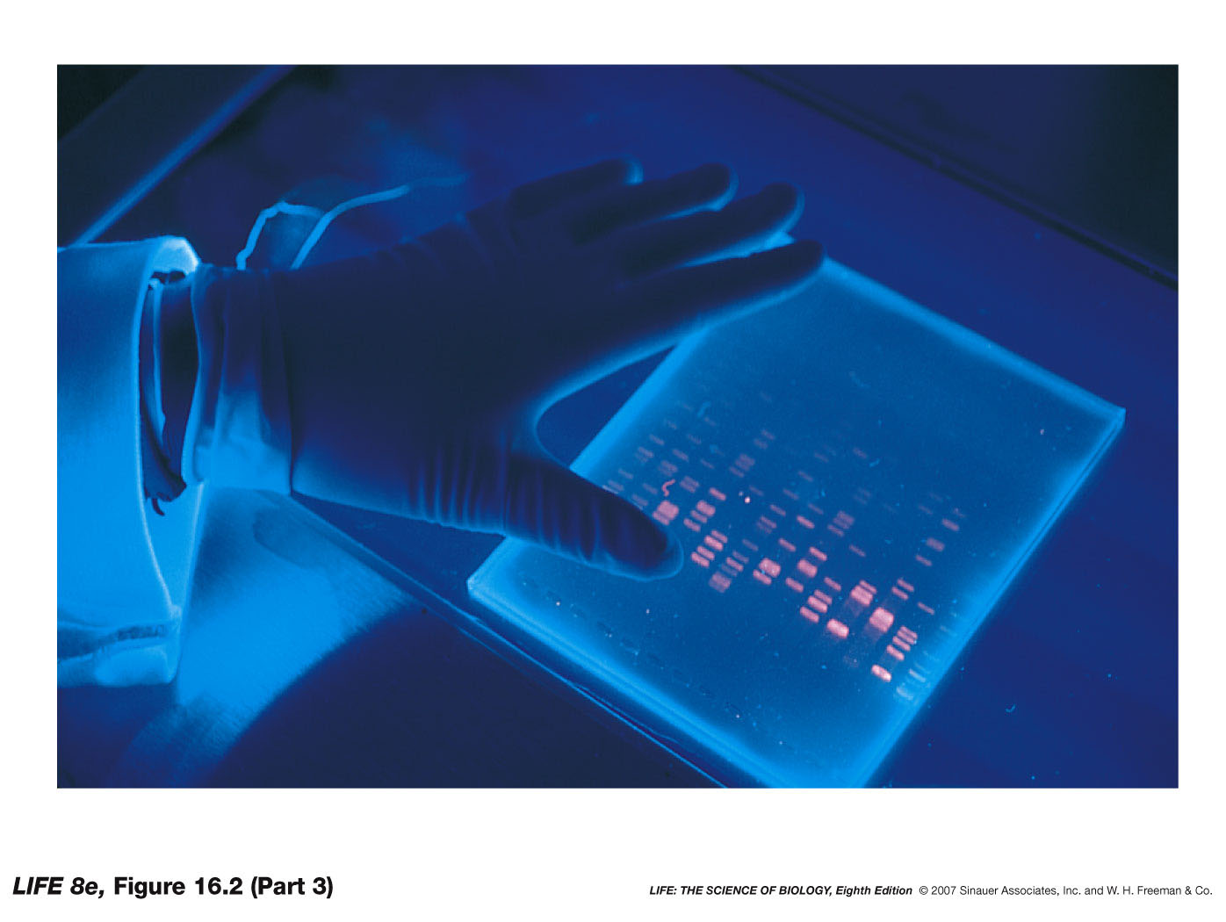
DNA on the gel is examined by:
staining DNA with a fluorescent dye
placing the plate under UV light.

Slide 47
Molecules are separated on the basis of their:
1. Size
Smaller molecules travel faster
2. Electrical charge
Negatively charged molecules move towards the positive pole
_
_
+
_

Slide 48
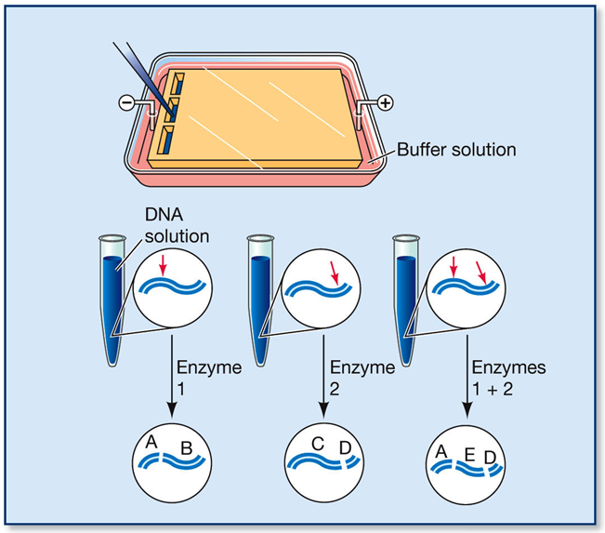
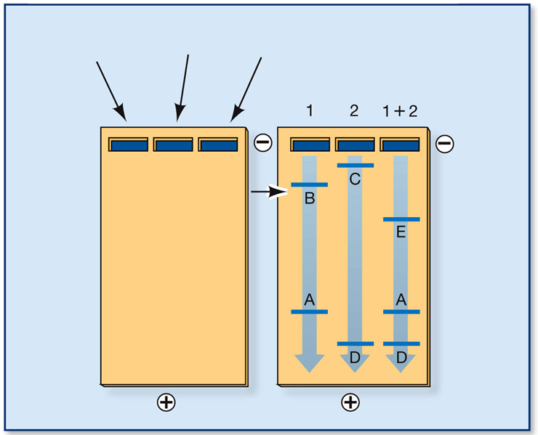
Gel electrophoresis
Each DNA fragment:
  stops at a different point on the gel
  can be removed in its pure form
  Different samples can be run side by side

Slide 49
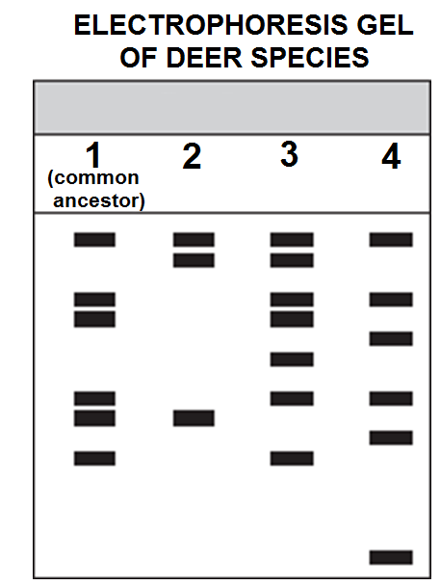
DNA fragments of
known lengths or molecular weight
are often run next to experimental mixtures for size reference.
Deer species

Slide 50
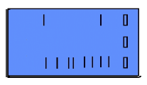
Which DNA fragment is small and which is large?
A
B
+
-

Slide 51
Which DNA fragment is small and which is large?
Small DNA fragment
Large DNA fragment
+
-

Slide 52
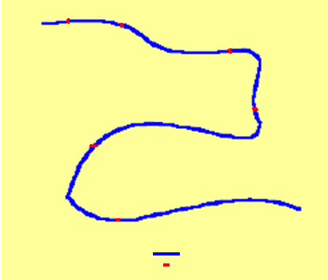

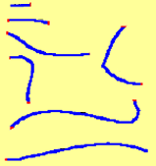
1
2
If six restriction sites are present, how many fragments will be obtained?
3
4
5
6
1
DNA
2
Restriction site
3
5
4
6
7

Slide 53
Cloning Vectors
The following are the features that are required to facilitate cloning into a vector.
(i) Origin of replication (ori) : This is a sequence from where replication starts and any piece of DNA when linked to this sequence can be made to replicate within the host cells.
This sequence is also responsible for controlling the copy number of the linked DNA
So, if one wants to recover many copies of the target DNA it should be cloned in a vector whose origin support high copy number.

Slide 54
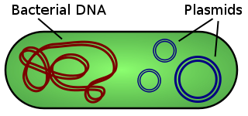
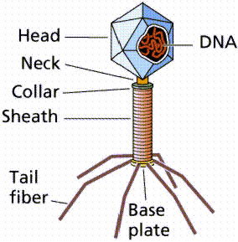
Two common vectors:
Plasmids:
small, extrachromosomal circles of DNA found in bacteria
Phages:
viruses that infect bacterial cells e.g.
λ phage (lambda phage)

Slide 55
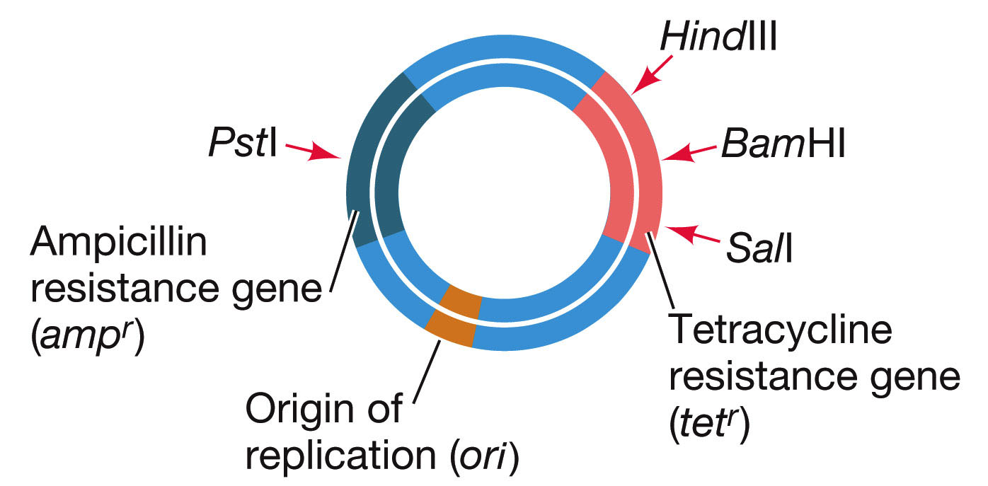
The plasmid pBR322
Was made in 1977
Is named for the two men who made it:
p-plasmid
B-Bolivar
R-Rodriguez
322-sequence number of plasmid

Slide 56
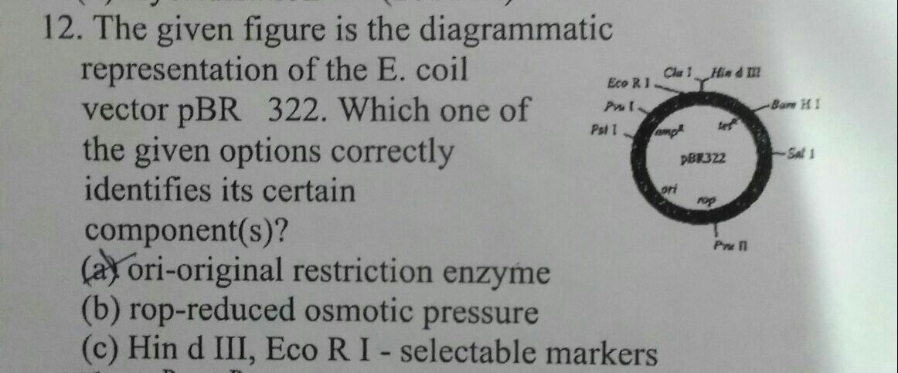

Slide 57
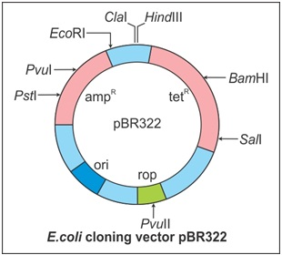
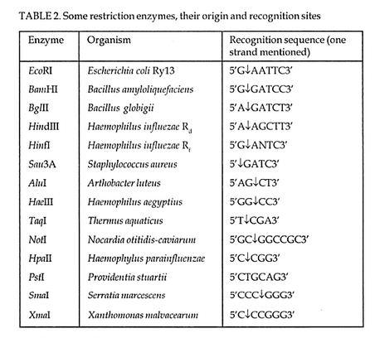
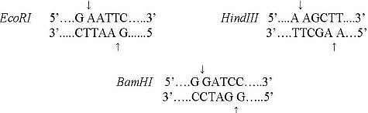

Slide 58
Cont……..
(ii) Selectable marker : In addition to ‘ori’, the vector requires a selectable marker, which helps in identifying and eliminating nontransformants and selectively permitting the growth of the transformants.
Transformation is a procedure through which a piece of DNA is introduced in a host bacterium (you will study the process in subsequent section).
Normally, the genes encoding resistance to antibiotics such as ampicillin, chloramphenicol, tetracycline or kanamycin, etc., are considered useful selectable markers for E. coli. The normal E. coli cells do not carry resistance against any of these antibiotics.

Slide 59
Cont….
(iii) Cloning sites: In order to link the alien DNA, the vector needs to have very few, preferably single, recognition sites for the commonly used restriction enzymes.
Presence of more than one recognition sites within the vector will generate several fragments, which will complicate the gene cloning (Figure 11.4).
The ligation of alien DNA is carried out at a restriction site present in one of the two antibiotic resistance genes.

Slide 60
Contin…..
For example, you can ligate a foreign DNA at the BamH I site of tetracycline resistance gene in the vector pBR322.
The recombinant plasmids will lose tetracycline resistance due to insertion of foreign DNA but can still be selected out from non-recombinant ones by plating the transformants on ampicillin containing medium.
The transformants growing on ampicillin containing medium are then transferred on a medium containing tetracycline. The recombinants will grow in ampicillin containing medium but not on that containing tetracycline.
But, nonrecombinants will grow on the medium containing both the antibiotics. In this case, one antibiotic resistance gene helps in selecting the transformants, whereas the other antibiotic resistancegene gets ‘inactivated due to insertion’ of alien DNA, and helps in selection of recombinants.

Slide 61
Cont….
(iv) Vectors for cloning genes in plants and animals :
The of transferring genes into plants and animals from bacteria and viruses which have known.
How to deliver genes to transform eukaryotic cells and force them to do what the bacteria or viruses want.

Slide 62
Eukaryotes as cloning vector
For example, Agrobacterium tumifaciens, a pathogen of several dicot plants is able to deliver a piece of DNA known as ‘T-DNA’ to transform normal plant cells into a tumor and direct these tumor cells to produce the chemicals required by the pathogen.
Similarly, retroviruses in animals have the ability to transform normal cells into cancerous cells.
A better understanding of the art of delivering genes by pathogens in their eukaryotic hosts has generated knowledge to transform these tools of pathogens into useful vectors for delivering genes of interest to humans.
The tumor inducing (Ti) plasmid of Agrobacterium tumifaciens has now been modified into a cloning vector which is no more pathogenic to the plants but is still able to use the mechanisms to deliver genes of our interest into a variety of plants.

Slide 63
Vectors for cloning genes in plants
Agrobacterium tumefaciens can cause the plant disease crown gall by transferring specific genes to the dicot plant.
A. tumefaciens contains a large plasmid called Ti plasmid which can deliver T- DNA to transform normal cell into a tumor and direct these tumor cells to produce the desired chemicals.
Plant genetic engineers have used this natural transformation system as a vehicle for the introduction of foreign DNA into plants.

Slide 64
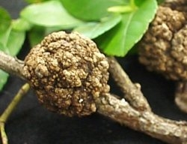
So what is Agrobacterium?????
A natural genetic engineer!!
Agrobacterium tumefaciens
is a soil bacteria that causes common plant tumours, commonly known as Crown Gall disease which affects a wide variety of plants.
The genome of Agrobacterium tumefaciens C58 has been sequenced completely and consists of a circular chromosome, a linear chromosome and two plasmids

Slide 65
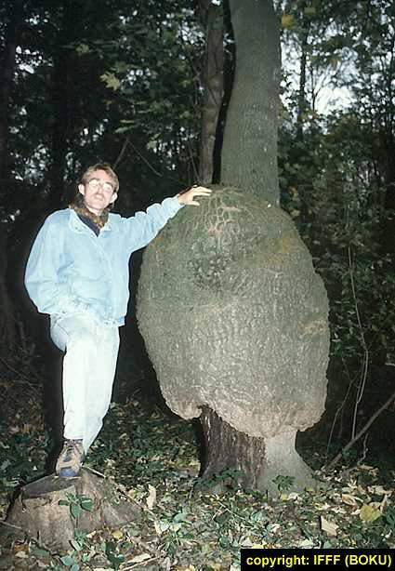
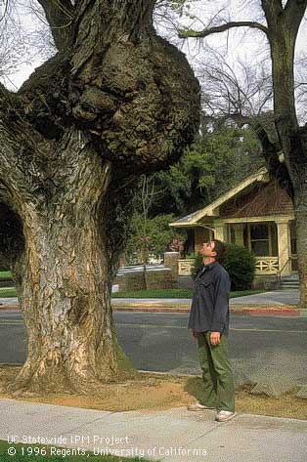
A. tumefaciens gall is not a tiny thing!!!!!

Slide 66
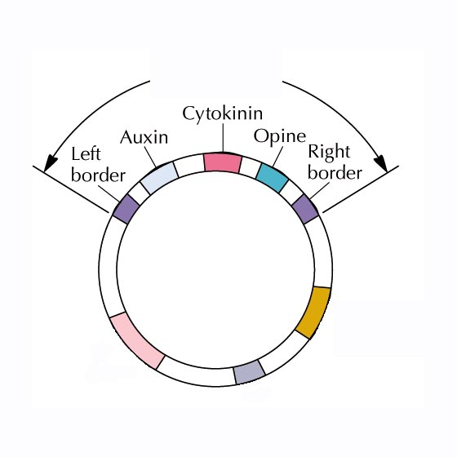
T-DNA
region
The Ti Plasmid
Tumor-
producing
genes
Opine
catabolism
Virulence region
ORI

Slide 67

During infection, the Ti plasmid is integrated into the plant chromosomal DNA

Slide 68


Slide 69


Slide 70
Vectors for cloning genes in Animals
Retroviruses in animals have the ability to transform the normal cells into cancerous cells.
Retroviruses are disarmed and now used to deliver desirable genes into animal cells.

Slide 71
Competent Host ( Transformation with Recombinant DNA)
Since DNA is a hydrophilic molecule, it cannot pass through cell membranes.
Bacterial cells must first be made ‘competent’ to take up DNA.
This is done by treating them with a specific concentration of a divalent cation, such as calcium, which increases the efficiency with which DNA enters the bacterium through pores in its cell wall.

Slide 72
Cont.
Recombinant DNA can then be forced into such cells by incubating the cells with recombinant DNA on ice, followed by placing them briefly at 42⁰ C(heat shock), and
Then putting them back on ice.
This enables the bacteria to take up the recombinant DNA.

Slide 73


Recombinant DNA enters host cells in a variety of ways
Viral
transfection
Microinjection
Chemically treating the cells by CaCl₂
Microprojection
(biolistics)
Electroporation

Slide 74

1. Calcium chloride is added to make host cells competent to take DNA
Artificial transformation
Bacterium
1. CaCl₂ treatment
2. Add recombinant DNA
to permeabilise cell
5. Bacteria are cultured
4. ‘Transformed’ bacterium

Slide 75


Microprojection (Biolistics)
Involves shooting tiny, high-velocity particles of tungsten, coated with the DNA
Gene gun
Bullet coated
with DNA
Gene gun
Gene becomes part of the cell DNA

Slide 76

Gene gun

Slide 77

Microinjection
More labour intensive as each cell is treated individually

Slide 78
Polymerase Chain Reaction
The origins of PCR are usually attributed to Kary Mullis, a technician at the Cetus Corporation, assigned to improve the synthesis of oligonucleotides.
He relates that he envisioned the concept PCR while on a camping trip with his girlfriend as part of his 1969 Nobel Prize lecture.
PCR was invented in 1984 by the American biochemist Kary Mullis at Cetus Corporation.

Slide 79


Slide 80


Polymerase Chain Reaction (PCR)
Technique used to amplify specific fragments of DNA

Slide 81
Polymerase Chain Reaction (PCR)
In this reaction, a small fragment of deoxyribonucleic acid (DNA) or gene can be rapidly cloned, or duplicated, to produce multiple DNA copies. It requires:-
Primers- small chemically synthesised oligonucleotides that are complementary to the regions of DNA.
Taq Polymarase - Thermostable DNA Polymerase isolated from Thermus aquaticus, a heat-loving bacterium found in the hot springs of Yellowstone National Park. It remain active during the high temperature.
Nucleotide Bases
Process :
1.Denaturation
2.Annealing and
3.Extention

Slide 82


Slide 83


Slide 84


Slide 85
PCR
One complete PCR cycle takes less than two minutes to complete.
Theoretically, the PCR cycle can be repeated indefinitely, but the polymerase, nucleotides, and primers are usually renewed after about 30 cycles. .
Thirty PCR cycles can produce 1 billion DNA copies in less than three hours.

Slide 86


Slide 87
PCR is a cyclic process involving the :
repetition of
three steps:

Slide 88
1. Denature
3’
5’
5’
3’
  Double-stranded DNA is heat-denatured into single strands.
3’
5’
5’
3’
2. Anneal
5’
3’
3’
5’
5’
3’
  Primers for DNA synthesis are added to the 3’ ends of the target DNA sequence on the separated strands
3’
5’
3. Extend
  DNA polymerase catalyses the production of new complementary strands

Slide 89

Heat to
denature: 95°C
[1 minute]
Cool to anneal: 40 °C
[45 seconds]
Extend: 70 °C
[2 minutes]

Slide 90
PCR produces billions of copies of a single piece of a DNA molecule in a few hours
2
1st cycle
4
2nd cycle
8
3rd cycle
16
4th cycle
32
5th cycle
64
6th cycle

Slide 91



The PCR reaction mixture contains:
1. A sample of double stranded DNA from a biological sample, to act as the template.
2. Two short, artificially synthesised primers that are complementary to the ends of sequence to be amplified.

Slide 92


3. The four dNTPs (deoxyribonucleoside phosphates: dATP, dTTP, dCTP, dGTP).
4. A DNA polymerase that can tolerate high temperatures without becoming degraded.
5. Salts and a buffer to maintain a near-neutral pH.

Slide 93

Taq polymerase
Is a heat-stable DNA polymerase
Obtained from the bacterium Thermus aquaticus
Replicates a 1000 base pair strand of DNA in less than 10 seconds at 72°C
/°C
/s

Slide 94


Thermus aquaticus – a thermophile
Found in hot springs
Survives up to 95°C

Slide 95

Why do the two primers have a different sequence?
The two 3' ends of DNA to be amplified are different.
T G G T
G A G T

Slide 96
PROCESSES OF RECOMBINANT DNA TECHNOLOGY
Recombinant DNA technology involves several steps in specific sequence such as
1.Isolation of DNA,
2.Fagmentation of DNA by restriction endonucleases,
3.Isolation of a desired DNA fragment,
4.Ligation of the DNA fragment into a vector,
5.Transferring the recombinant DNA into the host,
6.Culturing the host cells in a medium at large scale and
7.Extraction of the desired product.

Slide 97
Isolation of DNA,
Since the DNA is enclosed within the membranes, we have to break the cell open to release DNA along with other macromolecules such as RNA, proteins, polysaccharides and also lipids.
This can be achieved by treating the bacterial cells/plant or animal tissue with enzymes such as lysozyme (bacteria), cellulase (plant cells), chitinase (fungus).
The RNA can be removed by treatment with ribonuclease whereas proteins can be removed by treatment with protease.
Other molecules can be removed by appropriate treatments and purified DNA ultimately precipitates out after the addition of chilled ethanol.

Slide 98
2.Fagmentation of DNA by restriction endonucleases
Restriction enzyme digestions are performed by incubating purified DNA
molecules with the restriction enzyme, at the optimal conditions for that specific enzyme.
Agarose gel electrophoresis is employed to check the progression of a restriction enzyme digestion. DNA is a negatively charged molecule, hence it moves towards the positive electrode (anode) (Figure 11.3). The process is repeated with the vector DNA also.
The joining of DNA involves several processes. After having cut the source DNA as well as the vector DNA with a specific restriction enzyme, the cut out ‘gene of interest’ from the source DNA and the cut vector with space are mixed and ligase is added. This results in the preparation of recombinant DNA.

Slide 99
Amplification of Gene of Interest using PCR
PCR stands for Polymerase Chain Reaction. In this reaction, multiple copies of the gene (or DNA) of interest is synthesised in vitro using two sets of primers (small chemically synthesised oligonucleotides that are complementary to the regions of DNA) and the enzyme DNA Polymerase.
The enzyme extends the primers using the nucleotides provided in the reaction and the genomic DNA as template.

Slide 100
Insertion of Recombinant DNA into the Host Cell/Organism
There are several methods of introducing the ligated DNA into recipient cells. Recipient cells after making them ‘competent’ to receive, take up DNA present in its surrounding.
So, if a recombinant DNA bearing gene for resistance to an antibiotic (e.g., ampicillin) is transferred into E. coli cells, the host cells become transformed into ampicillin-resistant cells.
If we spread the transformed cells on agar plates containing ampicillin, only transformants will grow, untransformed recipient cells will die.

Slide 101
Obtaining the Foreign Gene Product
When you insert a piece of alien DNA into a cloning vector and transfer it into a bacterial, plant or animal cell, the alien DNA gets multiplied.
In almost all recombinant technologies, the ultimate aim is to produce a desirable protein.
If any protein encoding gene is expressed in a heterologous host, it is called a recombinant protein.
The cells harbouring cloned genes of interest may be grown on a small scale in the laboratory.

Slide 102
Bioreactors
Small volume cultures cannot yield appreciable quantities of products.
To produce in large quantities, the development of bioreactors, where large volumes (100-1000 litres) of culture can be processed, was required.
Thus, bioreactors can be thought of as vessels in which raw materials are biologically converted into specific products, individual enzymes, etc., using microbial plant, animal or human cells.
A bioreactor provides the optimal conditions for achieving the desired product by providing optimum growth conditions (temperature, pH, substrate, salts, vitamins, oxygen).
The most commonly used bioreactors are of stirring type, which are shown in Figure 11.7.

Slide 103


Slide 104


Slide 105


Slide 106
Downstream Processing
After completion of the biosynthetic stage, the product has to be subjected through a series of processes before it is ready for marketing as a finished product.
The processes include separation and purification, which are collectively referred to as downstream processing. The product has to be formulated with suitable preservatives.
Such formulation has to undergo thorough clinical trials as in case of drugs. Strict quality control testing for each product is also required.
The downstream processing and quality control testing vary from product to product.

Slide 107
Insertional inactivation.
Identification of Selective Marker can be also done by recombinants from non-recombinants on the basis of their ability to produce colour in the presence of a chromogenic substrate.
In this, a recombinant DNA is inserted within the coding sequence of an enzyme, β-galactosidase.
This results into inactivation of the enzyme, which is referred to as insertional inactivation.
The presence of a chromogenic substrate gives blue coloured colonies if the plasmid in the bacteria does not have an insert.
Presence of insert results into insertional inactivation of the â-galactosidase and the colonies do not produce any colour, these are identified as recombinant colonies.

Slide 108

The plasmids used as vectors in the laboratory:
Have been extensively altered by recombinant DNA technology to include convenient features such as multiple cloning sites with 20 or more unique restriction enzyme sites for cloning purposes

Slide 109




After a ligation reaction, not all the vector copies contain the foreign:
Plasmid present but
no recombinant DNA
No plasmid
Recombinant DNA

Slide 110

Marking recombinant DNA by inactivating a gene.
1
A plasmid has genes for resistance to both ampicillin (amp^{r}) and tetracycline (tet^{r}).
2
Foreign DNA is inserted at the BamHI recognition site, which is within the tet^{r} gene.
3
The resultant recombinant DNA has an intact functional gene for ampicillin resistance but not for tetracycline resistance .

Slide 111
If new DNA is inserted at that restriction site, it inactivates the gene for tetracycline resistance
Plasmid then has gene for ampicillin resistance, but not for tetracycline.
This can be used to select for host cells with new DNA.

Slide 112





Plasmid present but
no recombinant DNA
Recombinant DNA
No plasmid
Selectable marker (reporter) genes are used to select for bacteria that have taken up a plasmid.
A second reporter gene allows for the identification of bacteria harbouring the recombinant plasmid.

Slide 113


Replica Plating: an example of genetic selection
    is a technique for testing the genetic characteristics of bacterial colonies
handle
Velvet
(sterilised)
Ampicillin plate
Tetracycline plate
INCUBATE

Slide 114


Replica Plating: to identify colony having recombinant DNA
Ampicillin plate
Tetracycline plate

Slide 115


Genetic screening is another way to detect bacteria with recombinant DNA
one way to eliminate clones with vectors lacking an inserted DNA fragment is to use a vector that has:
antibiotic-resistance genes
the lacZ gene
Role of lacZ gene :
to produce the enzyme
β-galactosidase, that enables the cells to metabolise the sugar X-gal

Slide 116
As all cells with plasmids survive, it is not selection but Genetic Screening
bacteria that do not contain vectors are eliminated :
as medium contains antibiotic
colonies are identified from their colour

Slide 117
Inserting the foreign gene in a plasmid having the lac Z gene

Slide 118
Active lacZ gene: X-gal used = BLUE colony
Inactive lacZ gene: X-gal not used = WHITE colony

Slide 119


    lacZ gene:
    is intact
    produces β-galactosidase
    sugar X-gal is used [BLUE]
Foreign DNA
    lacZ gene:
    is inactive
    no β-galactosidase
    sugar X-gal is not used [WHITE]

Slide 120
REMEMBER:
Genetic screen
Genetic selection
bacteria with plasmid & those with recombinant DNA survive
bacteria with recombinant DNA are killed
Blue colony
Ampicillin plate
Tetracycline plate

